Slide 1

Covid-19 Tracker with Voice Assistant

Slide 2
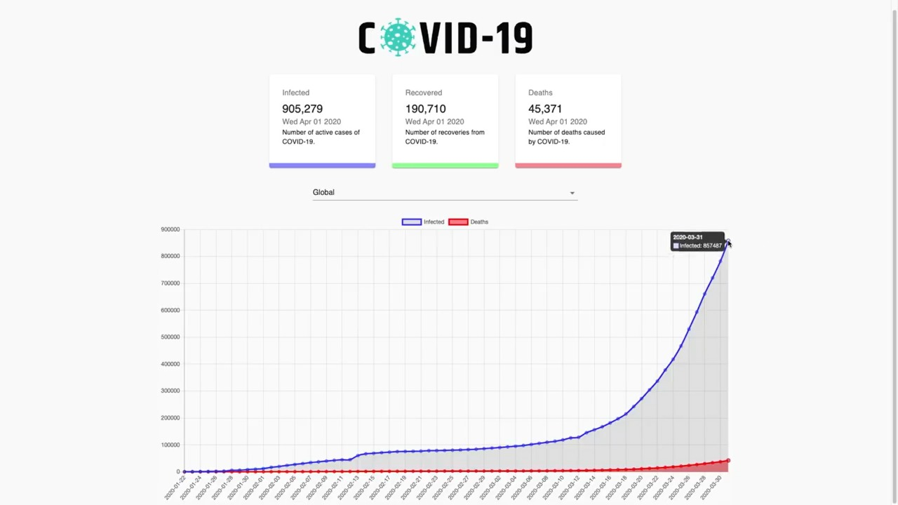
What is covid-19 Tracker ?
Here is the Expected Design of our Web App.
Its Show Number of infected , number of deaths and number of recovered cases along with the graphical representations.
How does it look like ?

Slide 3
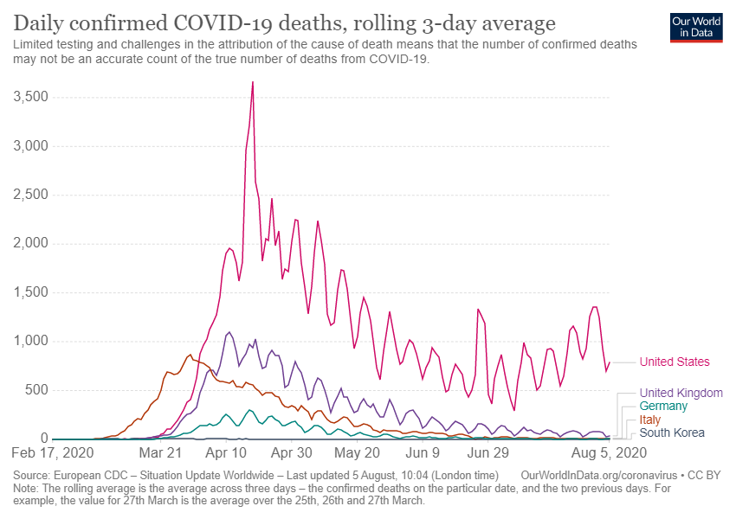
This chart shows the daily confirmed deaths due to COVID-19, given as the rolling average over three days.

Slide 4
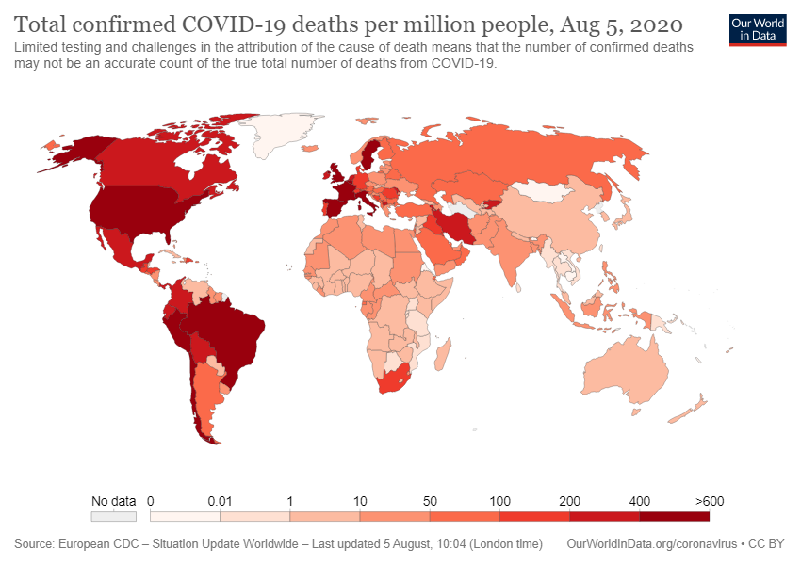
The previous chart looked at daily deaths per million people. This map shows total confirmed deaths per million people.

Slide 5
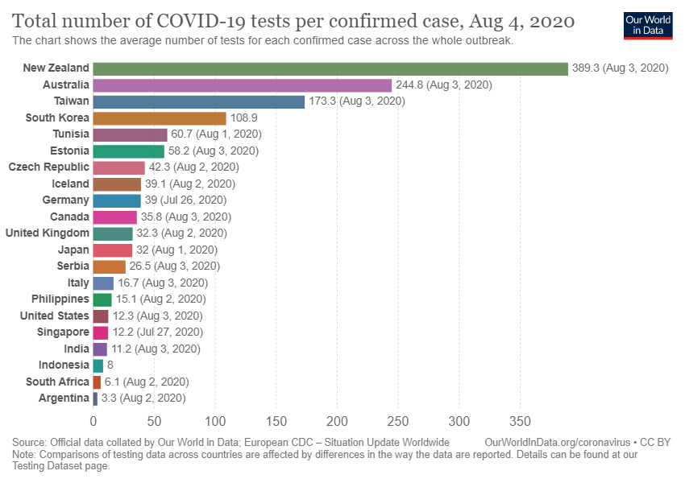
This chart brings our data on testing together with the data on confirmed cases.

Slide 6
Dataset
We are going to use a API:
Click on the link to have a look of the data: https://covid19.mathdro.id/api/

Slide 7

Voice Assistant
With voice assistant we will get daily updates about the cases as per the select Locations and here we will get notifications about it.

Slide 8
Thank You
1.Tushar Saxena
2.Divyanshi Bansal
3.Vipul
4.Ananya Jain
5.Umesh Pratap Singh

